Slide 1

KAKATIYA INSTITUE OF TECHNOLOGY AND SCIENCE WARANGAL
AIR BAG SYSTEM FOR TWO-WHEELER VEHICLE SYSTEM
BY
PROJECT SUPERVISOR:
SRI.M.ANIL KUMAR.
ASSISTANT PROFESSOR MED.
NAME OF STUDENTS:
SHASHANK(B18ME008)
NIKHITHA(B18ME009)
VAMSHIDHAR REDDY(B18ME011)

Slide 2
CONTENT
TITLE
ABSTRACT
INTRODUCTION
HOW DOES AIRBAG WORKS
IMPLEMENTATION PROCESS
LITERATURE REVIEW
DESIGN METHODOLOGY
ANALYTICAL PROCEDURE TO CALCULATE THE PRESSURE
FINAL SIMULATION
BUSSINESS PLAN AND COST SHEET
CONCLUSIONS AND FUTURE SCOPE
REFERENCES

Slide 3
ABSTRACT
The concept of this airbag system is “To reduce the injuries to a rider when impacting with an opposing vehicle in frontal collisions by absorbing rider kinetic energy and by reducing rider separation velocity from motorcycle in the forward direction.” With the help of the ANGLE sensor with an angle indicator and sense of the collision and the large frequency vibration for to open the air bag. Airbags in cars work by using the steering wheel and dash as a support with which to counter the force of the person being propelled forwards. On a scooter there is no such support, So by extending a large airbag upwards in just 0.04 seconds, the driver will be protected through a combination of the bag and the support of the vehicle/hard object they collide with. There is usage of the battery of bike for working system. The research will also include the working, construction, installation, and the problems regarding airbags. Some of the limitations perceived in deploying airbags are that two-wheeler riders are less likely to be in a fixed location with respect to the airbag at the point of impact and the lack of supporting surface. The nature of such impacts will be analyzed in the simulation for a proposed airbag system to estimate the head accelerations when the initial contact with the airbag is during the deployment phase.
Keywords: Airbag, Two-Wheeler Automotive, Impact, Design, Analysis, Injuries

Slide 4
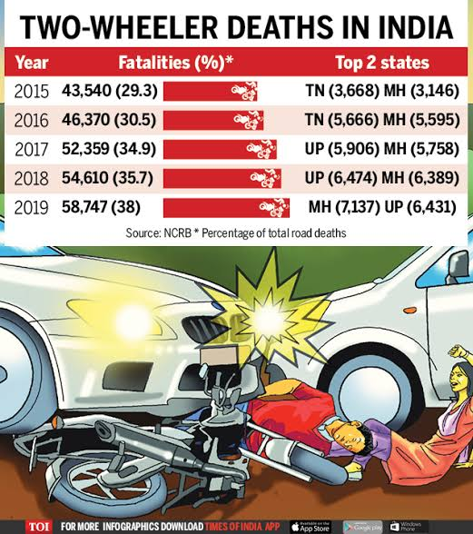
INTRODUCTION
First Introduced in four-wheeler
Reduce the injury to rider
Crash sensor
Reduce the death rate by 8% to 12%
Battery

Slide 5
HOW DOES AIRBAG WORKS
Airbag system is extremely complex and needs to activate within milliseconds after a crash
Some instruments are needed
Air bag
Design of strong leather grip technology air bag
Sensors
Chemical reactions
Inflator

Slide 6
AIR BAG
stretchable fabrics
These bags are compressed and kept in a small area
It consists of airbag cushion, a flexible fabric bag, an inflation module, and an impact sensor
soft cushioning

Slide 7
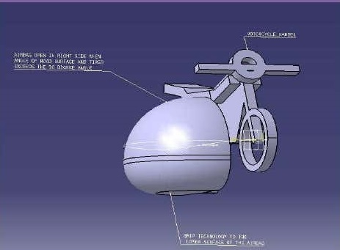
DESIGN OF STRONG LEATHER GRIP TECHNOLOGY AIR BAG
Nylon fabric
Grip technology
cornering
slipping & skidding

Slide 8
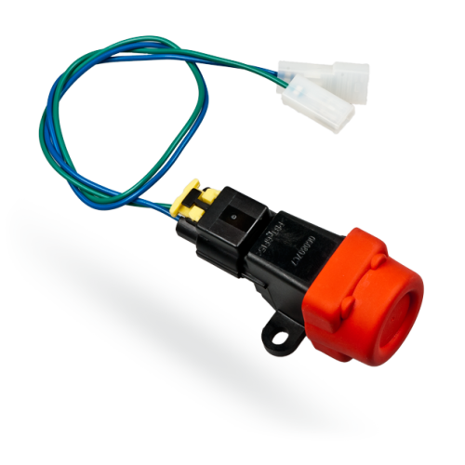
SENSORS
Very less response time
Placed near the front wheel
Sends the signal to airbag control unit
Mechanical sensors work independent of the electrical system
expensive

Slide 9
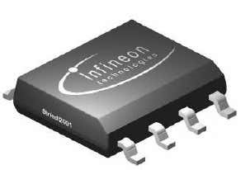
SENSORS
Angle sensor (TLE5012B)

Slide 10
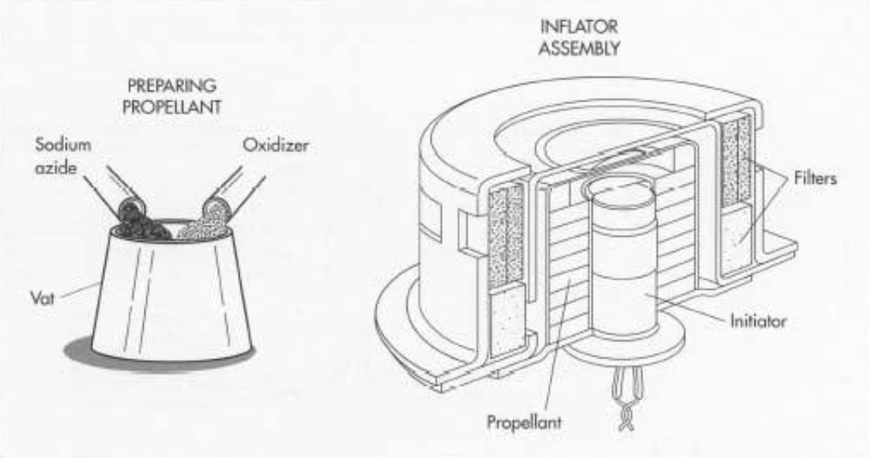
INFLATOR
It activates if signal comes from module unit
producing an explosion of nitrogen gas
Reaction time is less than 50 milliseconds

Slide 11
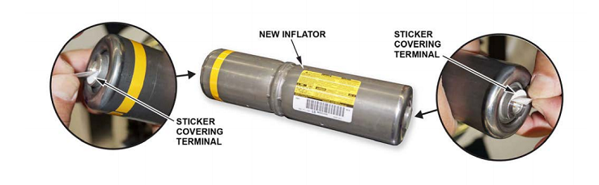
INFLATOR
One of the main component in air bag system
deflate itself on its own once it deploys automatically.

Slide 12
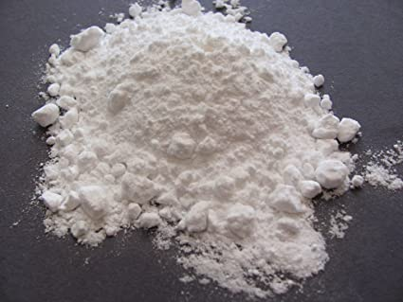
CHEMICAL REACTIONS
Nitrogen and its mixtures plays a major role
Sodium Azide (NaN3)
Potassium nitrate (KNO3) and
Silicon dioxide (SiO2)
Purpose of the KNO3 and SiO2 is to remove the sodium metal

Slide 13
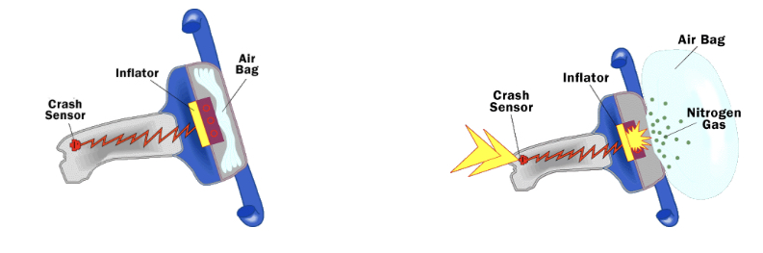
CHEMICAL REACTIONS
Reactions takes place In milli seconds
2NaN3—>2Na + 3N2(g)
10 Na+2 KNO3 —>K2O+5 Na2O +N2(g)
K2O+Na2O+2SiO2—> K2O3Si+Na2O3Si (silicate glass)

Slide 14
CHEMICAL REACTIONS
ideal gas law provides a good approximation of the relationship between the pressure and volume of the airbag and the amount of N2 it contains.
PV=nRT

Slide 15
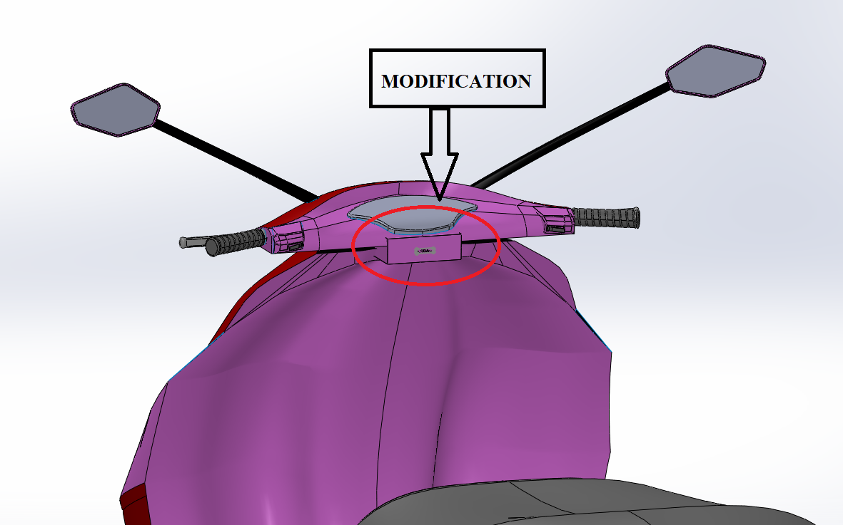
IMPLEMENTATION PROCESS
Modification under the dashboard
Small dia iron strips inside the air bag for the sake of stiffness
Angle sensor is placed near
the front wheel

Slide 16
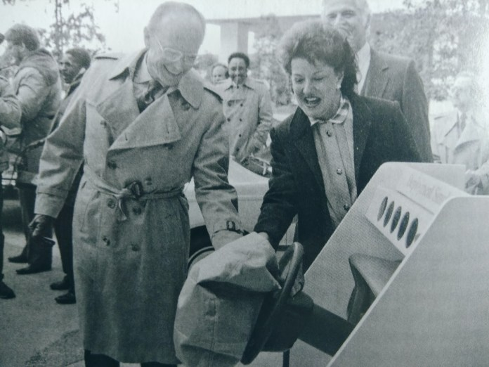
LITERATURE REVIEW
The first air bag concept was introduced in late 1950
Hetrick filed the patent with the U.S patent office in 1952
Developed Prototypes
Compressed air Tank

Slide 17
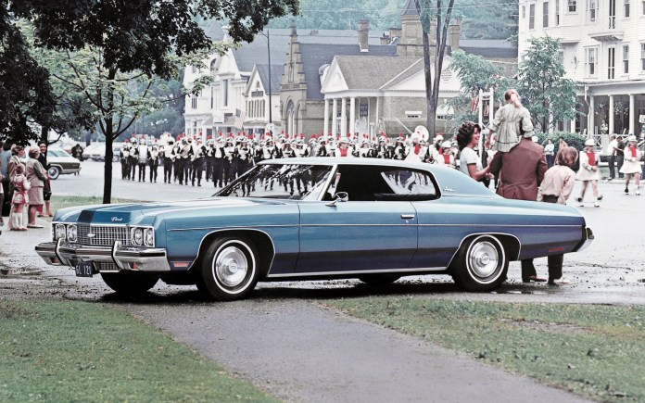
LITERATURE REVIEW
The first government fleet to have airbags as a safety feature

Slide 18
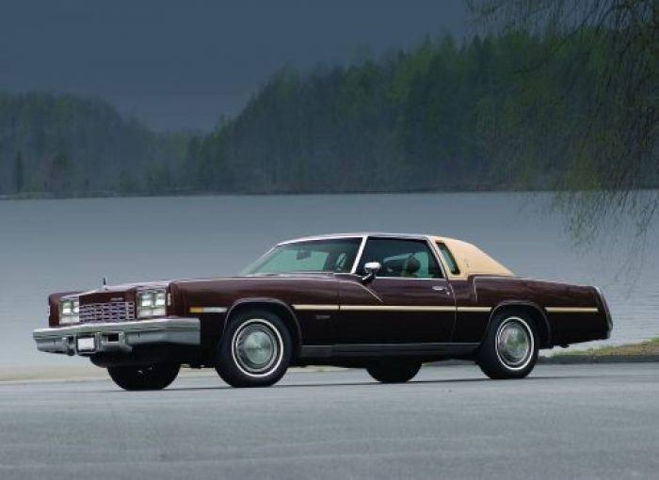
LITERATURE REVIEW
The First car to be domestically available with passenger airbags was GM’s Oldsmobile Toronado

Slide 19
IMPLEMENTATION PROCESS
For the bikes the implementation is completely different
Angle sensor activates when angle is less than 30 degrees
Two hemispherical air bags are placed

Slide 20
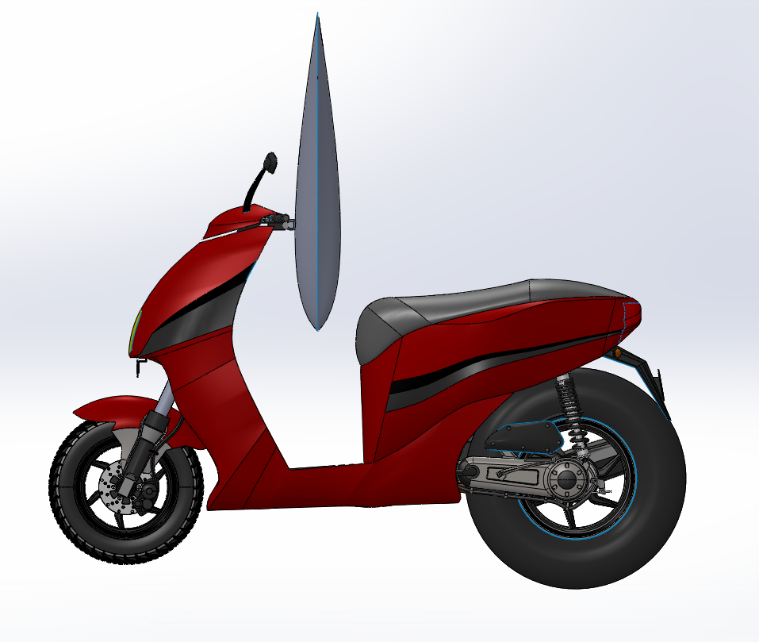
IMPLEMENTATION PROCESS
In scooty there is infinitesimal modification need to done
Angle sensor must place in the Centre of line of the chassis of the scooty

Slide 21
DESIGN METHODOLOGY
It’s a challenging task to design the air bag since there is no support
Some limitations for this design
Mass of the rider must be less than 65kg
Speed of the vehicle must be in economy speed

Slide 22
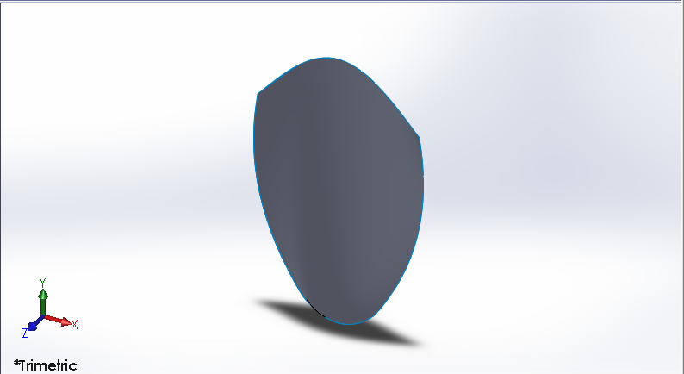
DESIGN METHODOLOGY
After research came to know that nylon is the best material for airbags
Multiple iterations are done
Dimensions :550x400x930(in mm)

Slide 23
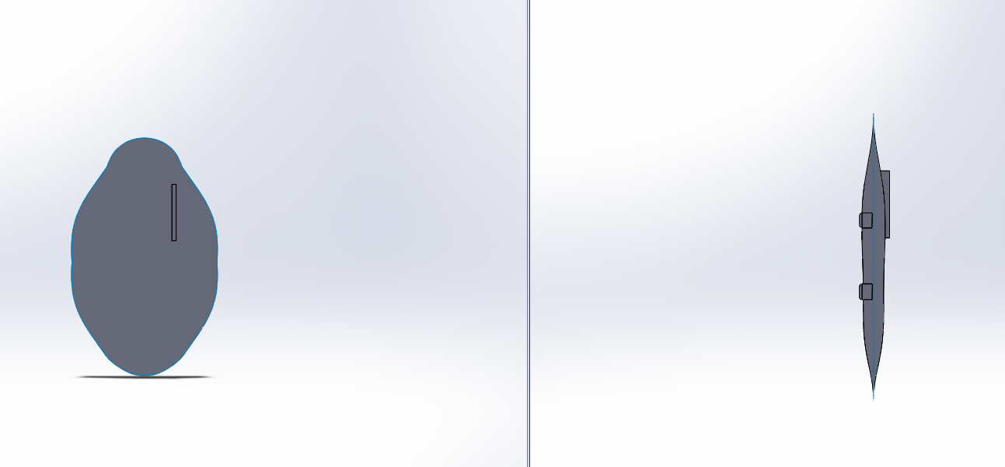
SIDE AIRBAGS
Stronger , thicker
This airbag will have many layer as it touches to ground
Airbag having special grip with two bumps like structure

Slide 24
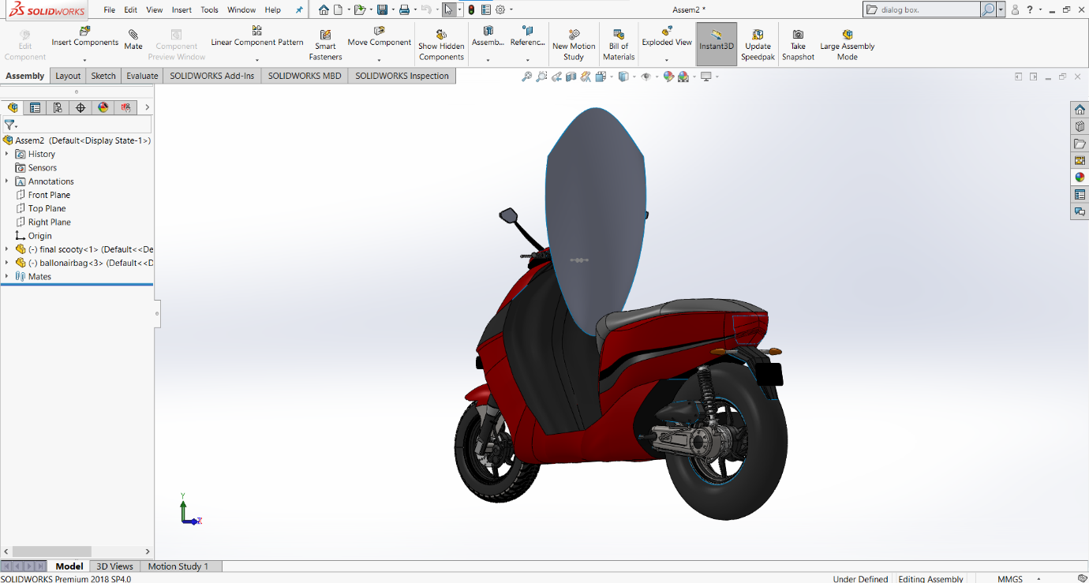
Assembly of front airbag and scooty at modification place

Slide 25
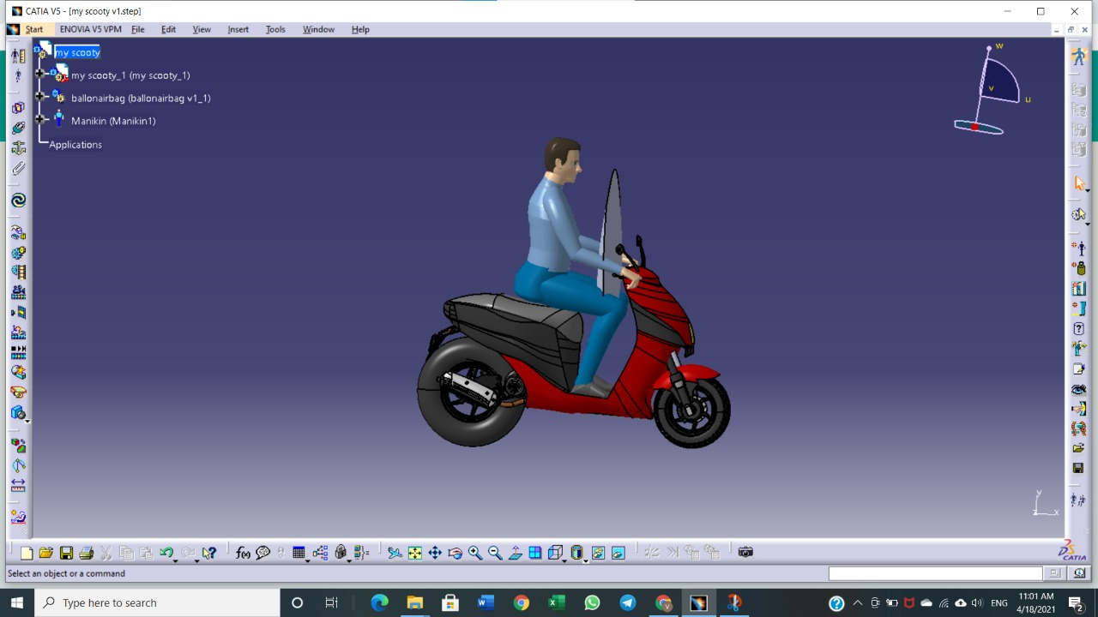
Assembly of front airbag. scooty and driver

Slide 26
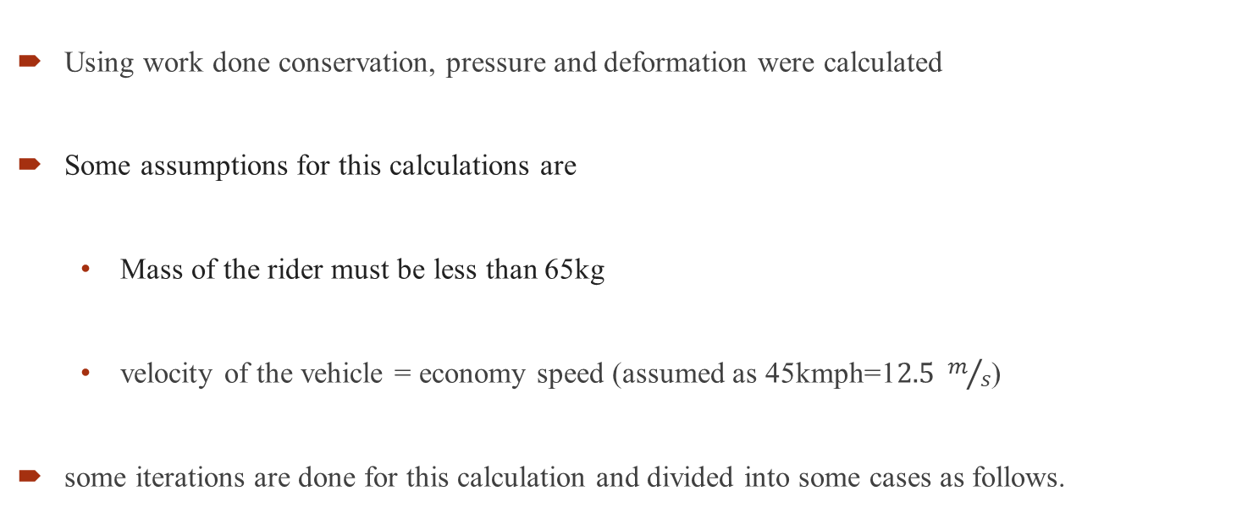
ANALYTICAL PROCEDURE TO CALCULATE THE PRESSURE
Using work done conservation, pressure and deformation were calculated
Some assumptions for this calculations are
Mass of the rider must be less than 65kg
velocity of the vehicle = economy speed (assumed as 45kmph=1$2.5 m/s$)
some iterations are done for this calculation and divided into some cases as follows.

Slide 27
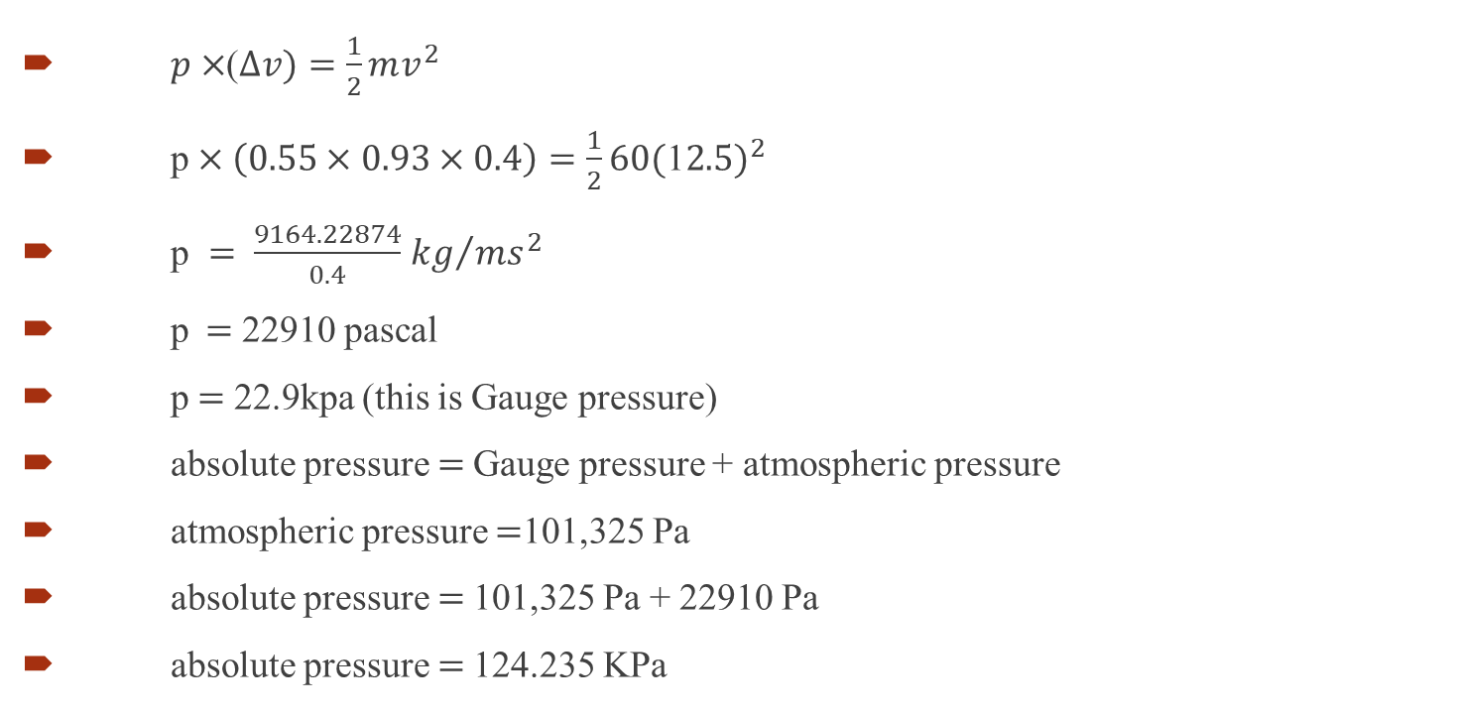
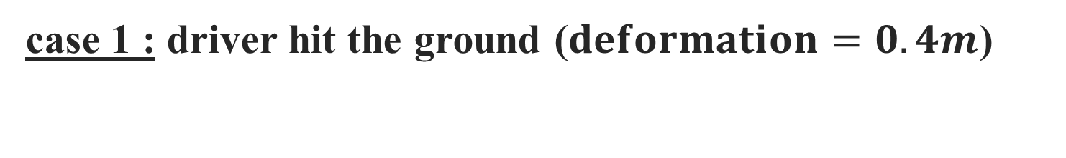
case 1 : driver hit the ground ($deformation=0.4m$)
$p×$($∆v)=\frac{1}{2}mv^{2}$
p$×\left(0.55×0.93×0.4\right)=\frac{1}{2}60{(\text{1}2.5)}^{2}$
p $= \frac{9164.22874}{0.4}$ ${kg}/{ms^{2}}$
p$=$22910 pascal
p$=$22.9kpa (this is Gauge pressure)
absolute pressure $=$Gauge pressure + atmospheric pressure
atmospheric pressure $=$101,325 Pa
absolute pressure $=$101,325 Pa + 22910 Pa
absolute pressure $=$124.235 KPa

Slide 28
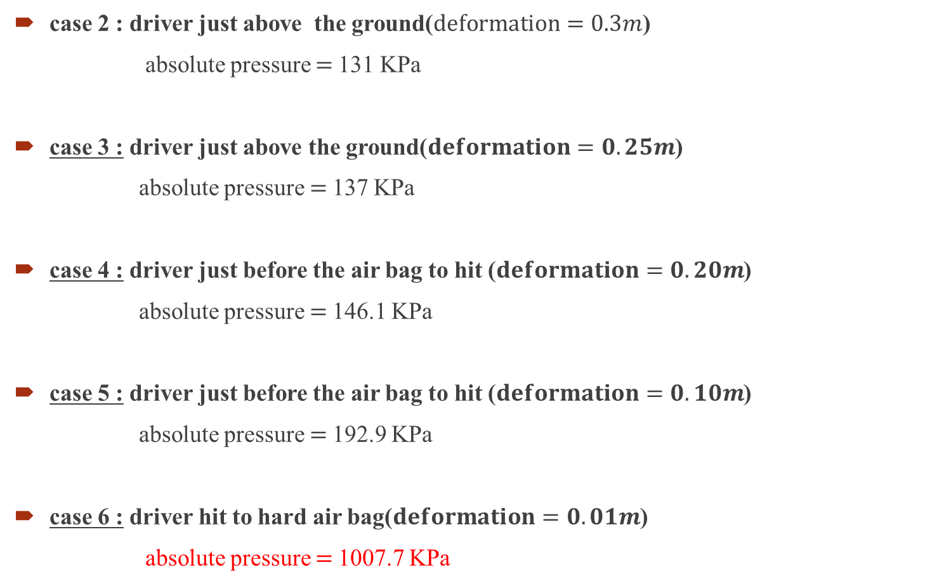
case 2 : driver just above the ground($deformation=0.3m$)
absolute pressure $=$131 KPa
case 3 : driver just above the ground($deformation=0.25m$)
absolute pressure $=$137 KPa
case 4 : driver just before the air bag to hit ($deformation=0.20m$)
absolute pressure $=$146.1 KPa
case 5 : driver just before the air bag to hit ($deformation=0.10m$)
absolute pressure $=$192.9 KPa
case 6 : driver hit to hard air bag($deformation=0.01m$)
absolute pressure $=$1007.7 KPa

Slide 29
GRAPH BETWEEN DEFORMATION OF AIR BAG VS PRESSURE INSIDE THE AIR BAG

Slide 30
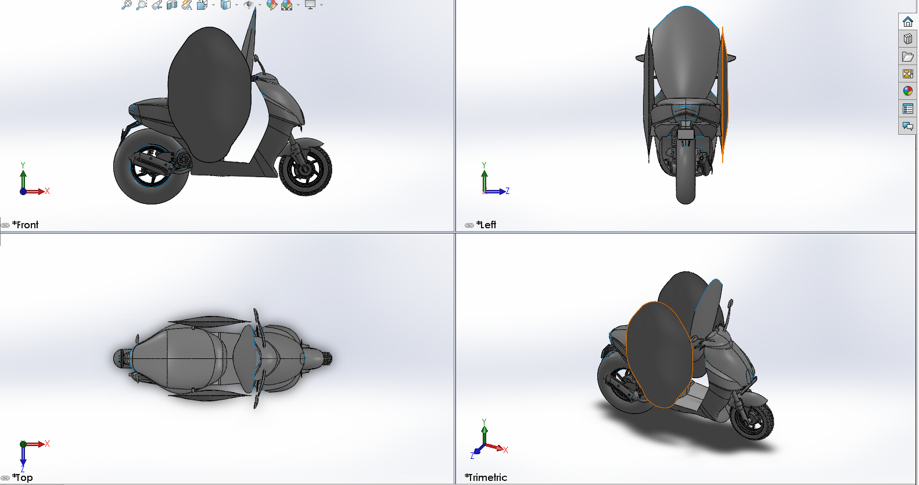
FINAL SIMULATION

Slide 31
AIR BAG SYSTEM : TWO-WHEELER
BUSSINESS PLAN AND COST SHEET

Slide 32
THOUGHTS….!
Why should a two wheelers have safety ?
Are two wheelers life not so important ?
Personal Experience..!

Slide 33
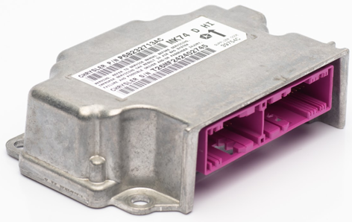
EXECUTION
Dashboard of Two-wheeler.
Controlling unit.
Sensor inclusion.
Air Bag Module.

Slide 34
DIFFERNTIATION.
Safety to Rider and vehicle.
World class quality product.
Hand making with advancements.

Slide 35
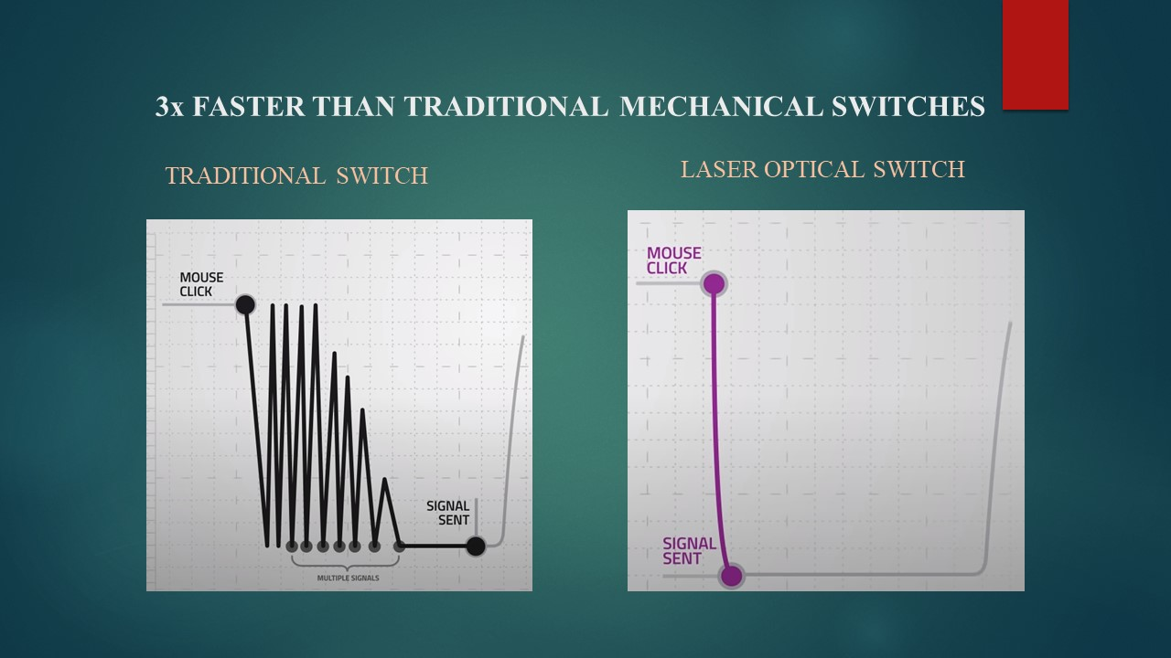
DIFFERNTIATION
Shutter mechanism
Laser technology in sensors
0.2 milliseconds

Slide 36

COST SHEET
Components | Cost
vehicle | 82300
Air bag | 33519.67
Control Unit | 11172.13
Inflator | 1489.77
Control module | 29795.42
Smart Feature | 1000
Total Cost | 159276/-

Slide 37
CONCLUSIONS AND FUTURE SCOPE
With this we can conclude that the pressure inside the airbag must be greater than the 124.2KPa.
Pressure inside the air bag must be less than 1007.7 KPa.
Two-wheeler death rate will shoot south side by 8% (E).
We save the upcoming generation of nation India.

Slide 38
REFERENCES
[1] Honda Develops, “World’s First Production Motorcycle Airbag System” September 8, 2005 - Honda Motor Co., Ltd
[2] S. Mukherjee, A. Chawla, Jayant Jangra, “Studies for Motorcycle Airbags” Transportation
research and Injury prevention program. Indian Institute of Technology New Delhi 110016.
[3] Joseph S. Merola, a chemistry professor and associate dean of the College of Arts and Sciences at Virginia Tech, offers this explanation.
[4] R. Capitani and S.S Pellari, R Lavezzi, Brembo “Design and numerical evaluation of an airbag jacket for motorcycle”, 25, 24035(BG) Italy.
[5] THE AIRBAG SYSTEM FOR 2-WHEELER VEHICLE SYSTEM BY Rishikesh H. Tike, Prof. Mukesh C. Chaudhari.

Slide 39
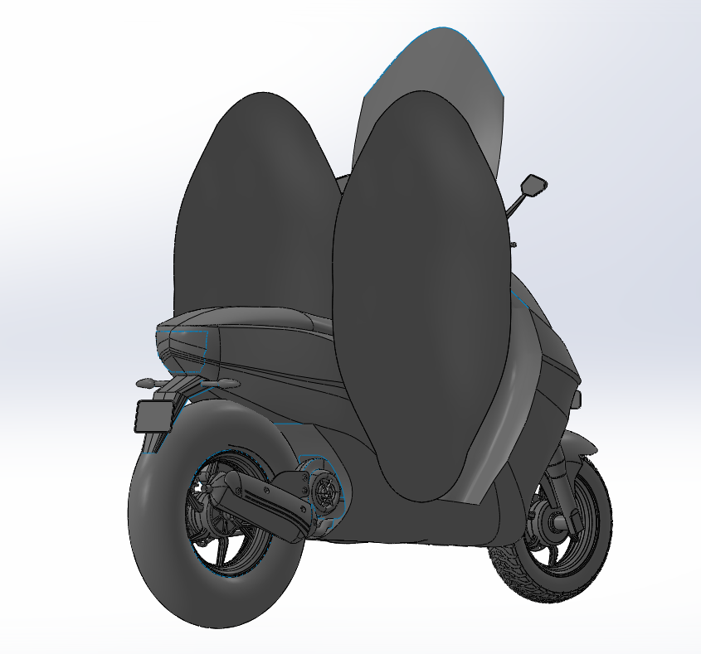
VIDEO PITCH

Slide 40
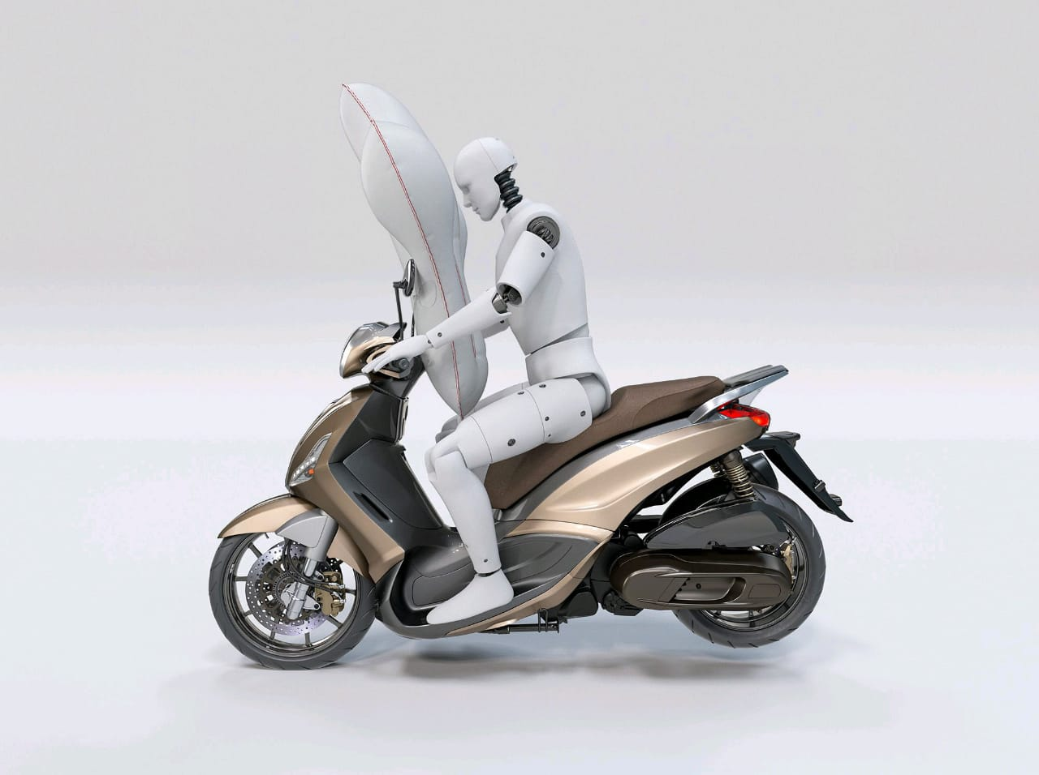
Q &A

Slide 41
THANK YOU

